Slide 1
Introduction to Arduino
Communicative plants and small scale urban farming
Joanne Armitage

Slide 2

Workshop Aim
By the end of this workshop you will have achieved the following
Learnt some basic programming in Arduino
Tested some different soils for moisture content
Setup sensors to help you monitor the wellbeing of your plant
Notes:
https://www.tiagoespinha.net/2014/05/project-how-to-easily-monitor-your-plants-soil-humidity/

Slide 3
Arduino Intro
The Arduino is a tool known as a microcontroller; it is basically a device that you can use externally from, or in conjunction with a computer to sense and control physical inputs and outputs. With a focus on enhancing interactivity, the Arduino can be used as a standalone device, or interfaced with your computer to control other software packages.
You can buy Arduinos pre-assembled, there are also many variations of the Arduino, known as clones, that you can assemble yourself. To support the physical side of the Arduino, there is a free and open source software that allows you to easily program the microcontroller.

Slide 4

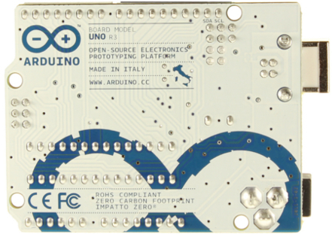
Welcome to Arduino
Below is a the Arduino board, this is the physical hardware of the Arduino.
You can get a few different types of Arduino boards, but today we will be working with the UNO!
The Arduino Uno
(Source: http://processing.org/tutorials/gettingstarted/)

Slide 5
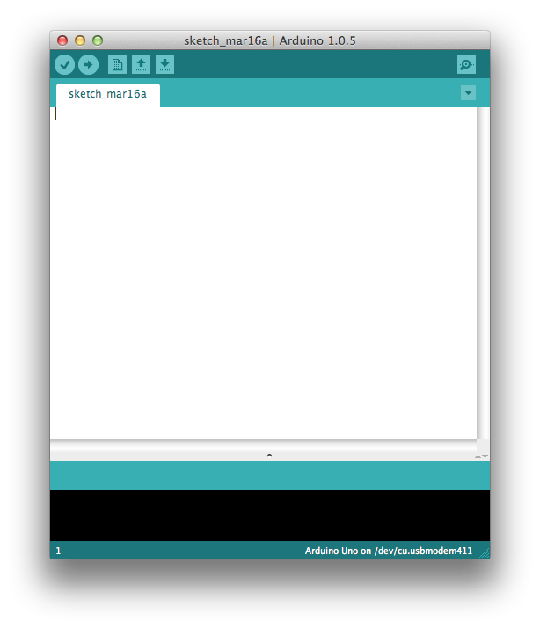
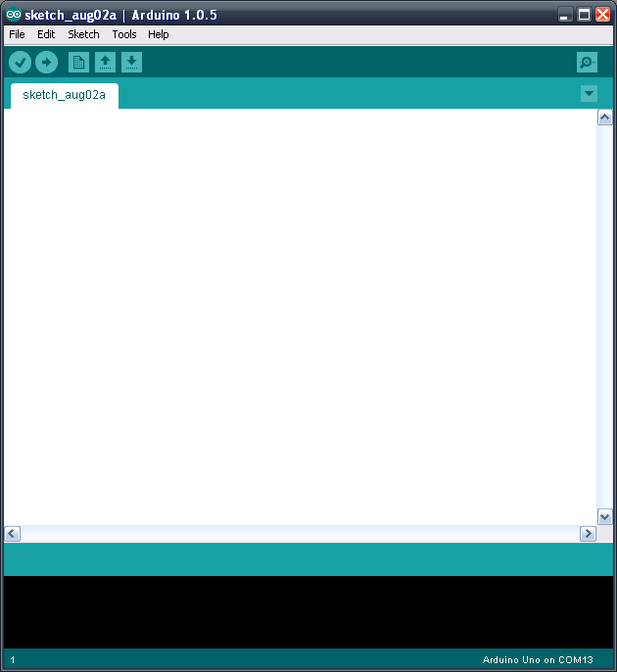
Welcome to Arduino
This is the Arduino Integrated Development Environment, or IDE this is the software side Arduino. You’ll be writing your programs in here, these are known as sketches.
If you’ve already installed the Arduino IDE – open it up.
If you need a hand installing then give me a shout!
The Arduino IDE 1.0.5 -> OSX (L) and Windows (R)
(Source: http://panasonic.mironto.sk/wp-content/uploads/arduino_ide.png)

Slide 6
Useful links
Arduino Reference: Look up code in the Language Reference guide
Tutorials: Explore Arduino more using their Learning page.
Forum: Ask for a hand in Arduino’s help forum

Slide 7
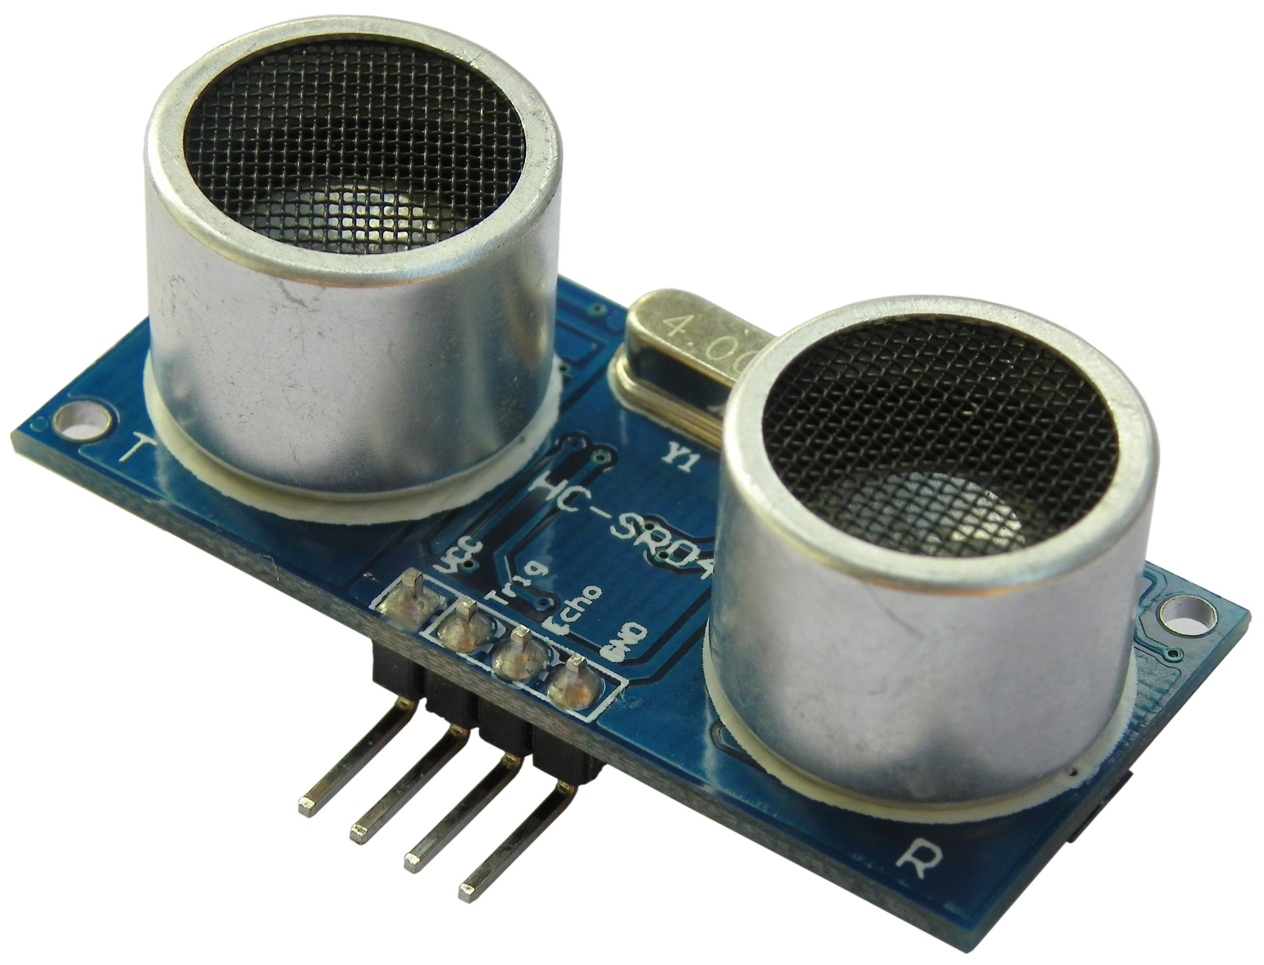
What we will be doing today!
During this session we will be connecting the Arduino to an Ultrasonic Sensor, used to measure distance (think radar), and a speaker!
The idea is to build a simple Theremin inspired Arduino based noise maker (see here for a Theremin example)
Ultrasonic Sensor
(Source: http://www.robosoftsystems.co.in/wikidocs/images/archive/8/84/20130108065629!HC-SR04.jpg)

Slide 8
Workshop Tools
In front of you, you should find:
1 x Arduino UNO
1 x USB Cable
1 x Breadboard
1 x Speaker
1 x Ultrasonic Sensor
1 x Resistor
8 x Wires
Today we are going to be working on breadboard – a quick way of prototyping ideas without getting gunged up with messy soldering and wire cutters.
Notes:
Has everybody got everything?

Slide 9
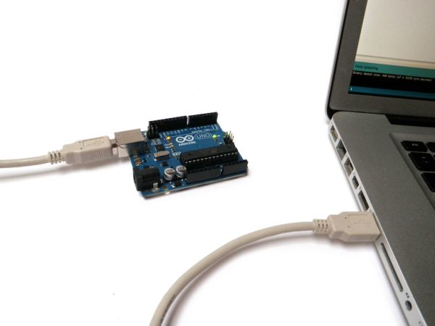
Connecting the Arduino
Plug the Arduino into your laptop using the USB Cable.
This allows your laptop to communicate with your Arduino using serial data and vice versa. Make sure it’s plugged in when you’re uploading code to it.
Now go into the Arduino IDE on you laptop to select the right board by going:
Tools > Board > Arduino Uno
You then need to select the port
Tools > Port
Connecting the Arduino to your Laptop
(Source:http://duino4projects.com/introduction-to-arduino/)
Notes:
Has everybody got everything?

Slide 10
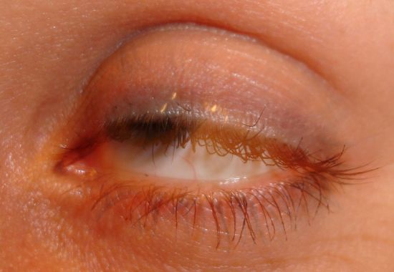
BLINK ;)
So the first thing we are going to do is make the Arduino blink, more specifically an LED on the Arduino blink.
We’re going to take a bit of time going over this code as it’s full of useful examples to get you familiar with programming in the Arduino IDE.
(Source: http://www.tumyeto.com/images/uploaded/---blink-eye_opt.jpg)

Slide 11
BLINK ;)
Copy and paste the following code into a new sketch in the Arduino IDE:
const int ledPin = 13; // LED is on pin 13. Won’t change so set as constant
// put your setup code here, to run once:
void setup() {
pinMode(ledPin, OUTPUT); // set pin direction
}
// put your main code here, to run repeatedly:
void loop() {
digitalWrite(ledPin, HIGH); // turn LED on
delay(1000); // delay 1000ms
digitalWrite(ledPin, LOW); // turn LED off
delay(1000); // delay 1000ms
}
Notes:
Talk through the code

Slide 12
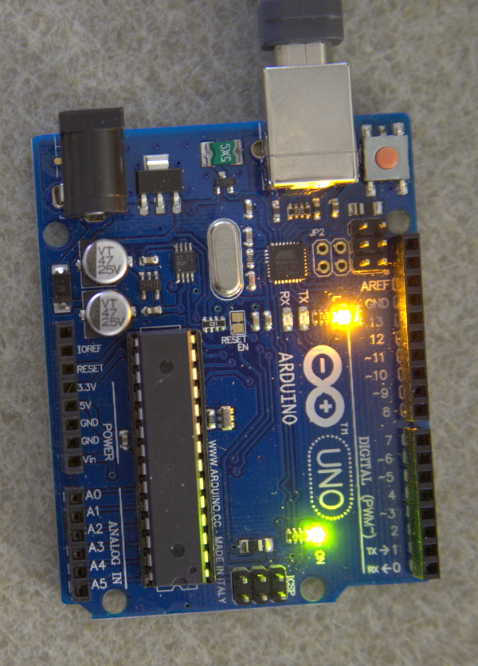
BLINK ;)
Then click
Pressing this button tells the Arduino IDE to compile you code, which basically means check it for any errors and upload it to the Arduino.
If everything has worked successfully, the LED circled in the picture below should be blinking ON and OFF every second.
Blinking Arduino
(Source: http://www.benbarbour.com/content/arduino/Tutorial1.1/just_arduino_led_high.png)

Slide 13
BLINK ;)
The value you put in the delay is in milliseconds. So putting a value of 1000 in makes it blink on and off ever second, 500 is half a second etc. etc.
Experiment changing the delay values to create different blinking effects, you can even add more delays in if you fancy!
Try changing the OFF/LOW value till you can’t see the LED turning off.
Important things to note:
Every line of code ends with a semicolon “;” to separate different statements.
“//” is used to make comments in the code that the machine ignores. This is helpful when trying to remember what each bit of your code does.

Slide 14
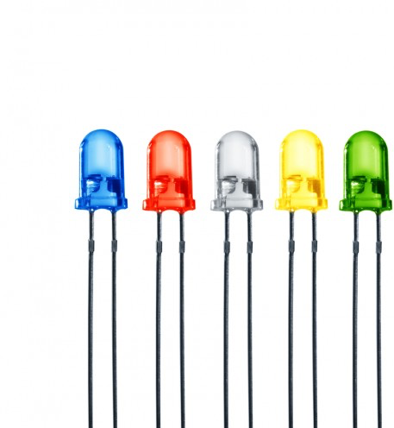
LED:: INTRO
LED stands for light-emitting diode.
In the simplest terms, an LED is a semiconductor device that emits light when an electric current is passed through it.
Light is produced when the particles that carry the current (known as electrons and holes) combine together within the semiconductor material.

Slide 15
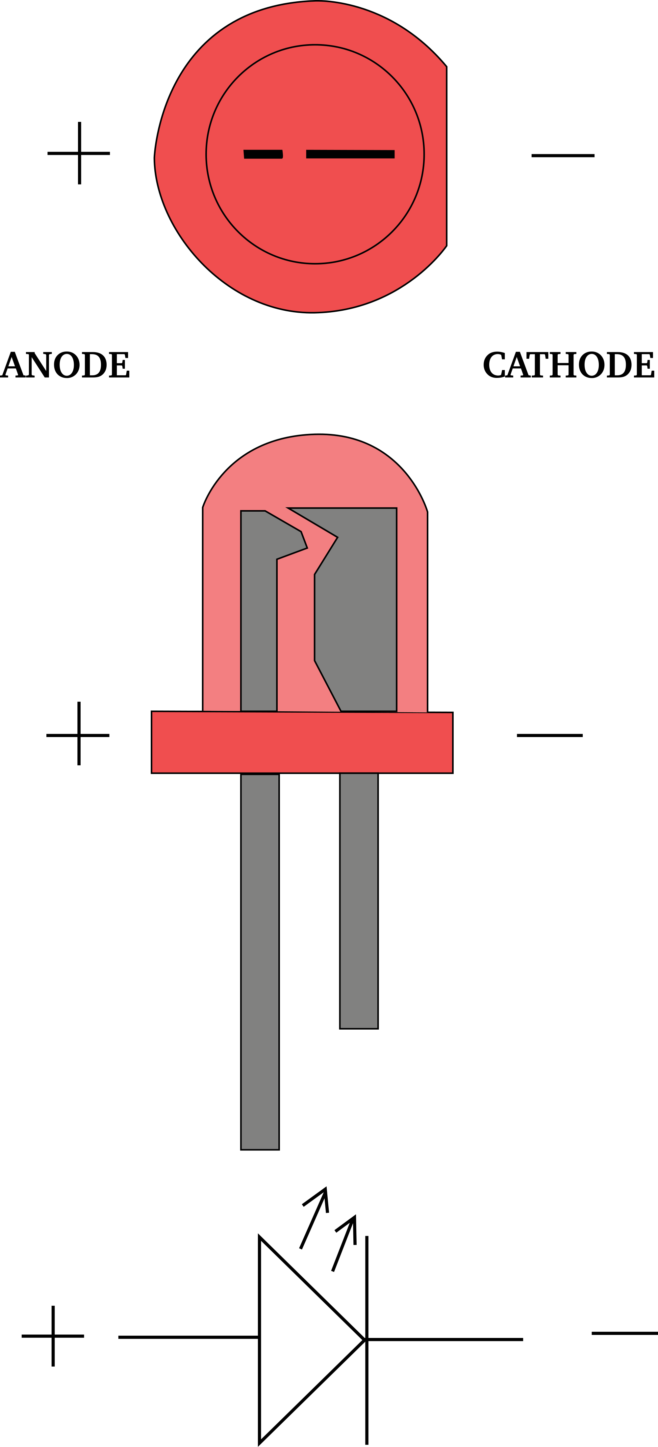
LED:: ANODE + CATHODE
Diodes only allow current to flow in one direction, and they’re always polarized. A diode has two terminals. The positive side is called the anode, and the negative one is called the cathode.
There are a handful of identifiers for finding the positive and negative pins on an LED. You can try to find the longer leg, which should indicate the positive, anode pin.
Or, if someone’s trimmed the legs, try finding the flat edge on the LED’s outer casing. The pin nearest the flat edge will be the negative, cathode pin.

Slide 16
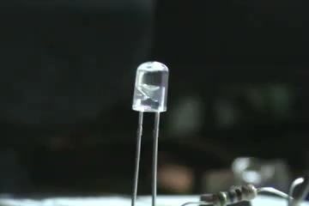
LED:: CURRENT LIMITING RESISTOR
A resistor (current limiting resistor) in series with an LED is essential to ensure you do not blow up your LED when you apply power to it, the resistor will limit the amount of current flowing through the two components to a safe value.

Slide 17
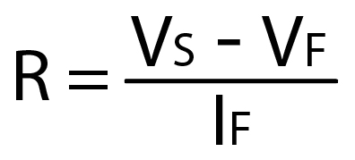
LED :: CALCULATE RESISTOR
To calculate the value of your current limiting resistor (R) you will need to know:
Vf: The LEDs typical forward voltage
If: The LEDs forward current
Vs: the supply voltage
The typical forward voltage is the voltage that the LED needs to light up, this can be anywhere between 1.7V and 3.4V, it varies depending upon the colour of the LED.
The forward current for basic LED’s is usually about 20mA, the current through the LED should be equal to or less than this current rating.
Notes:
So it came to 280R, from the standard resistor values available we could choose either a 270R or a 300R resistor. It’s always a better idea to go for the higher value, the LED is going to come on with either value but with the higher valued resistor the current will be less.

Slide 18
LED :: GETTING THE VALUES
We are using 3 different LEDs from Farnell
RED
GREEN
ORANGE
Get the data sheet from each link and calculate the resistor required for each.
There should be a different value for each LED

Slide 19
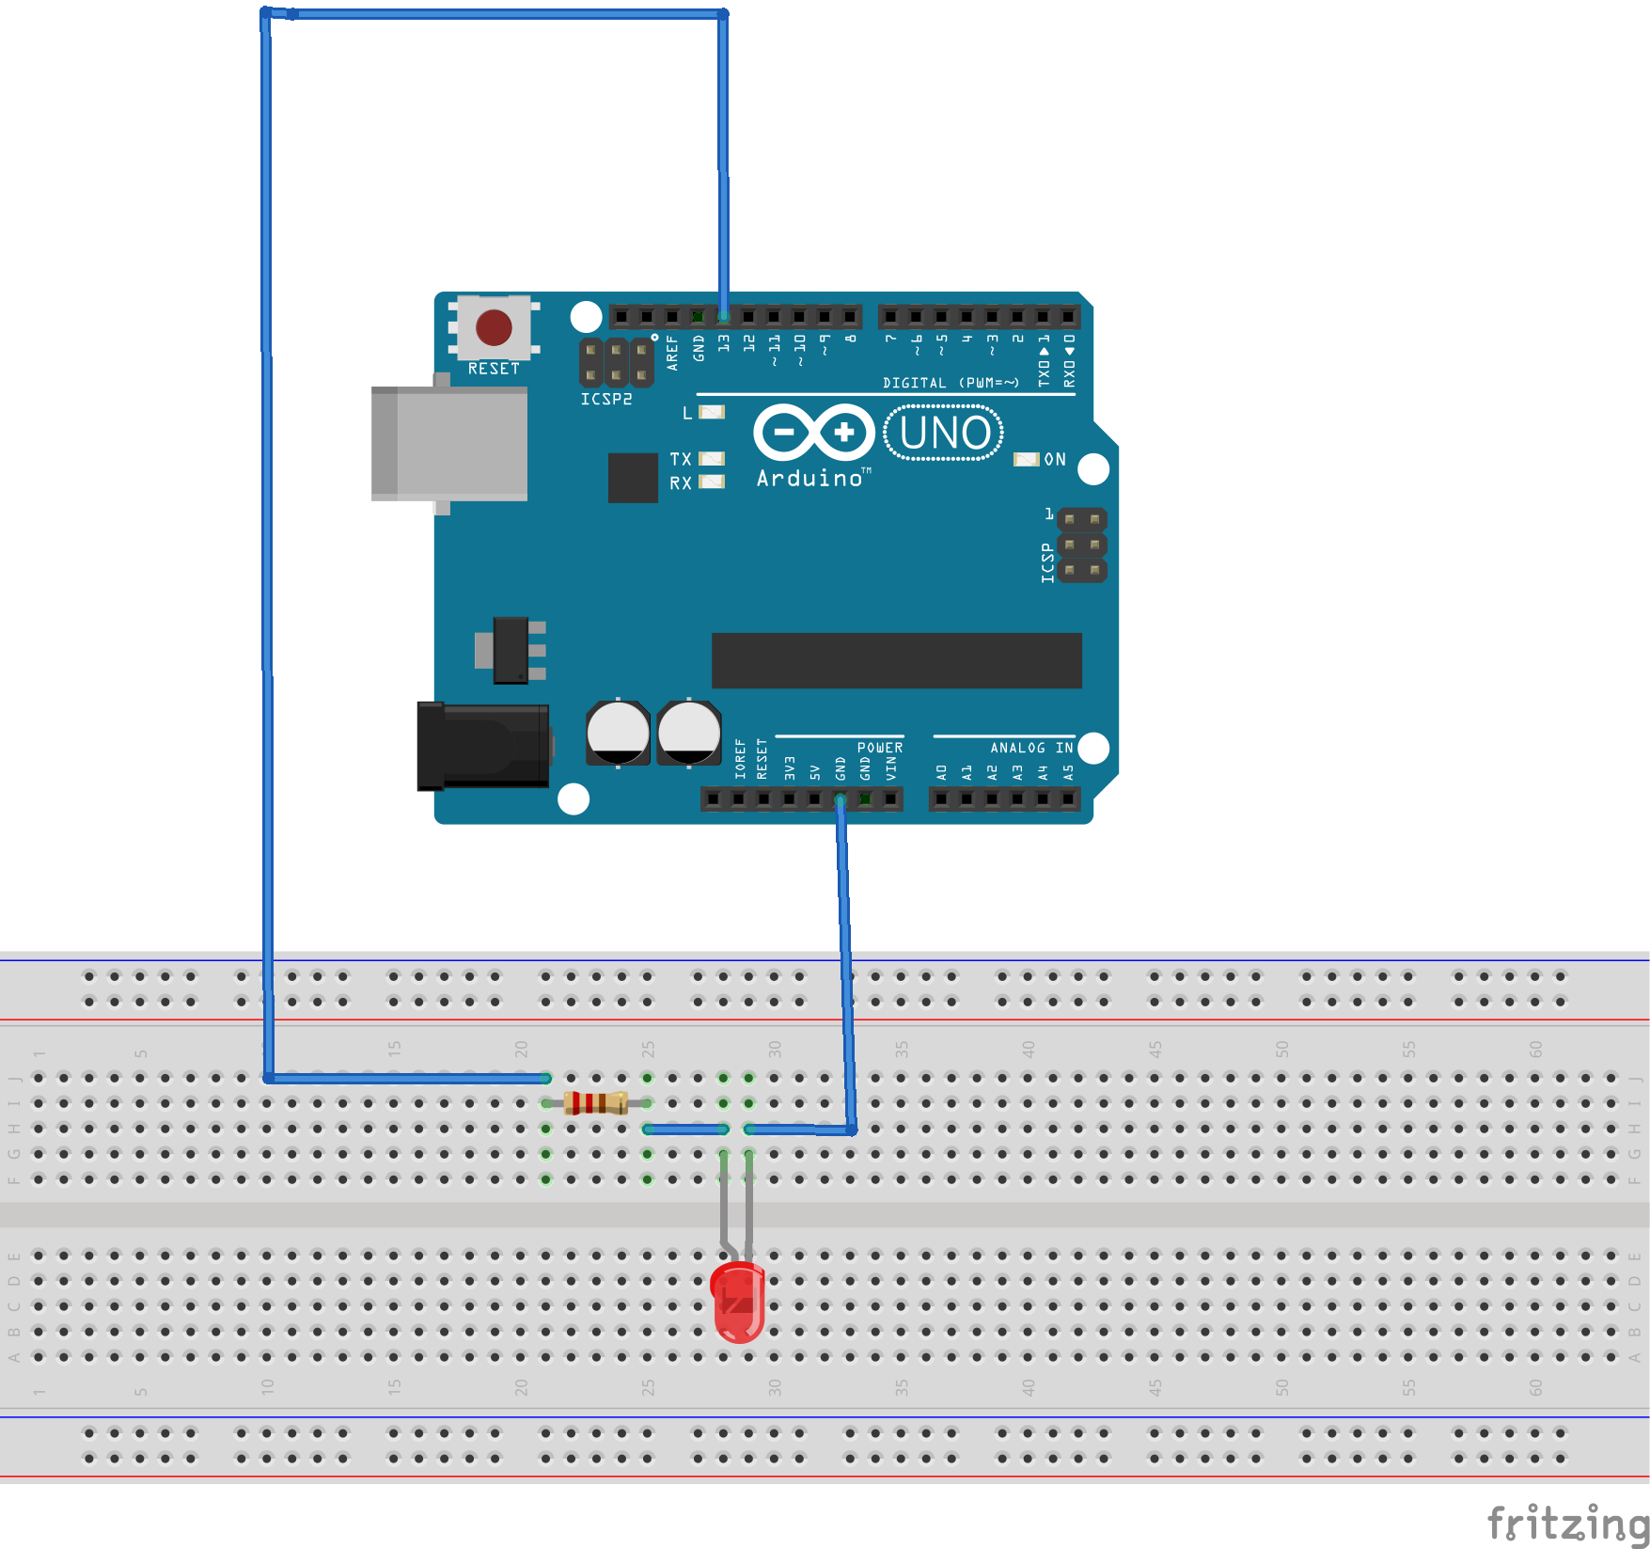
LED :: BUILDING THE CIRCUIT
Assemble your board as shown below

Slide 20
LED :: CODING THE ARDUINO
Open up the three_leds.pde file
Run the code – your LEDs should flash on and off in turn.
Try some other patterns?
Can you make a traffic light?

Slide 21
Adding Libraries
The Arduino IDE can be extended through the use of libraries. They provide extra functionality for use in sketches and can be contributed by anyone in the community.
Libraries are a collection of code that makes it easy for you to connect to a sensor, display, module, etc. For example, the built-in LiquidCrystal library makes it easy to talk to character LCD displays.
We are using the NewTone library to make it easier to get the Arduino playing sound from the speaker.
You’ll find a folder called New Tone in the download file.
You can get more info for the library here.
Notes:
There are 2 gnd pins on the Arduino

Slide 22
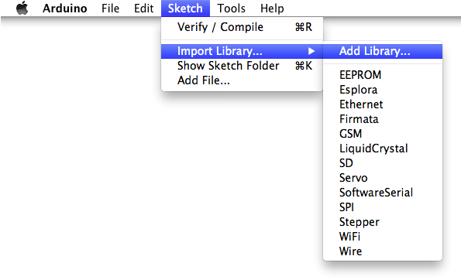
Adding Libraries
Once the Library is downloaded, you need to install it in Arduino.
First unzip the file by clicking on it.
In the Arduino IDE navigate to Sketch > Import Library. At the top of the drop down list, select the option to "Add Library''.
Notes:
There are 2 gnd pins on the Arduino

Slide 23
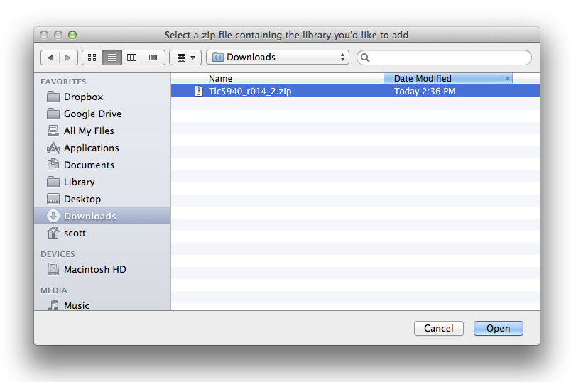
Adding Libraries
You will be prompted to select the Library you would like to add. This will be in the downloads folder of your computer. Navigate to the files location and open it.
Notes:
There are 2 gnd pins on the Arduino

Slide 24
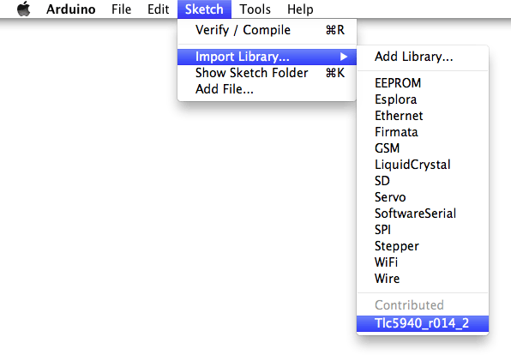
Adding Libraries
Return to the Sketch > Import Library menu, you should now see the New Tone library at the bottom of the drop-down menu.
Notes:
There are 2 gnd pins on the Arduino

Slide 25
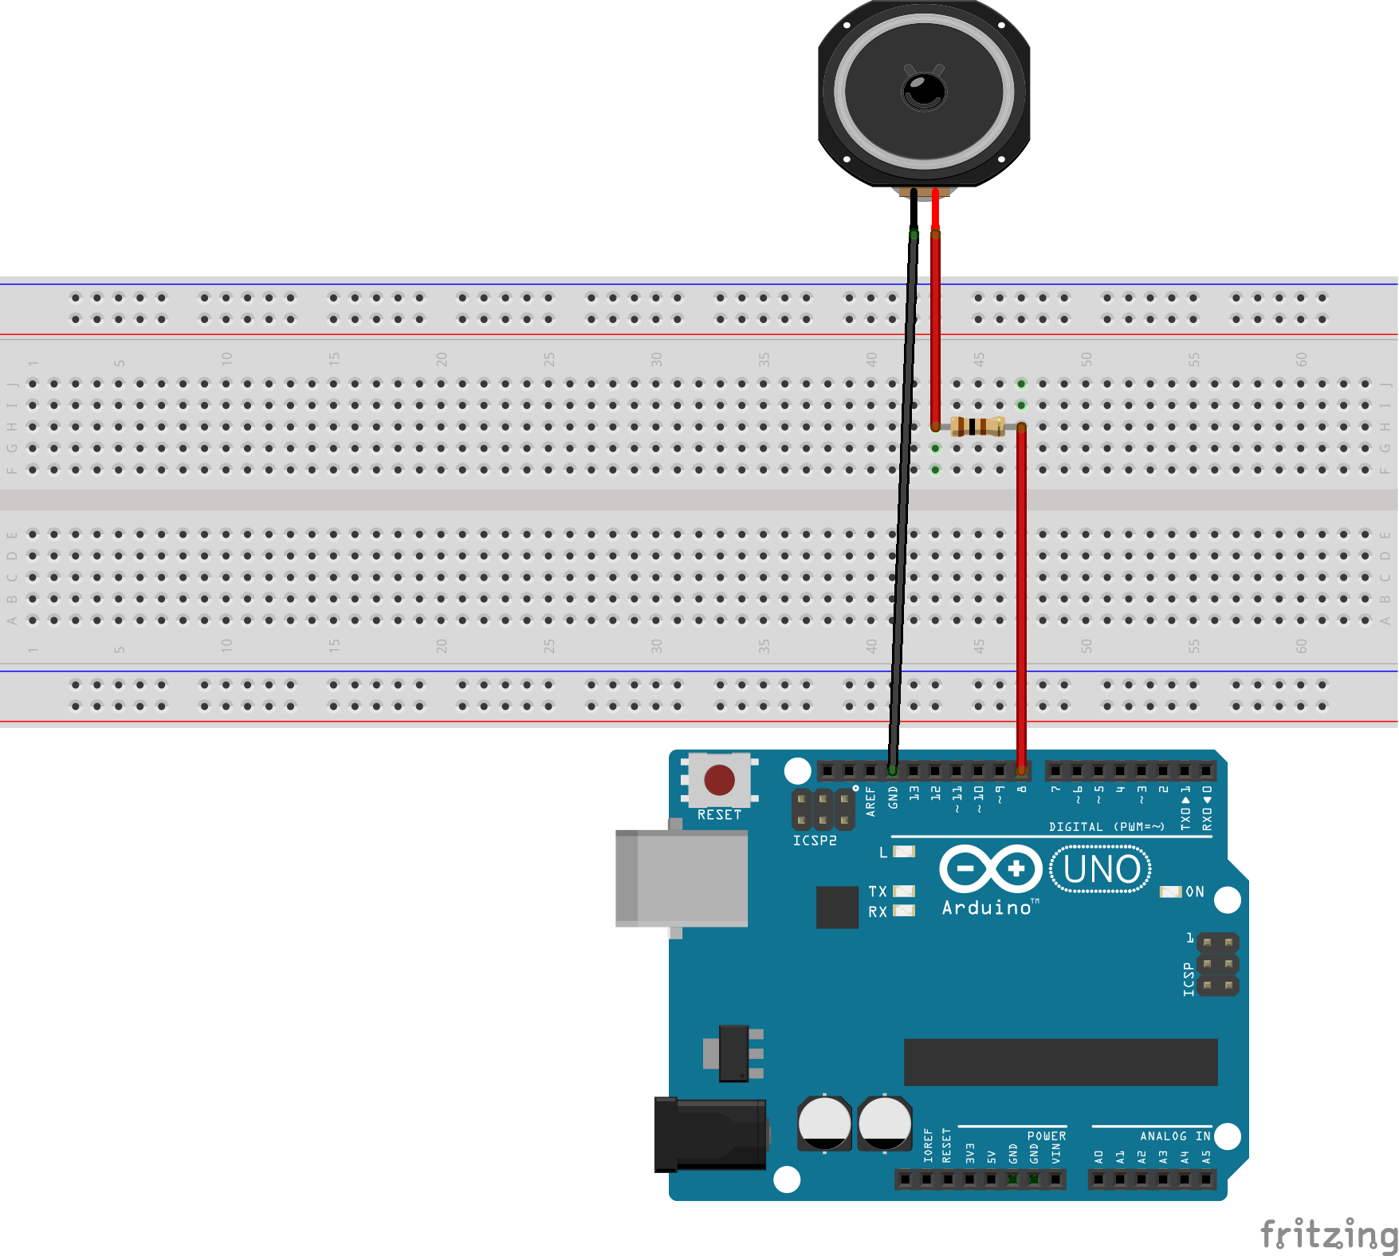
Make some noise!
Now we’re going to build some hardware! First connect the speaker to the Arduino like in the diagram below.
Connect one wire on the speaker to GND
Connect the other speaker wire in series with a resistor then to pin 8 on the Arduino.

Slide 26
Make some noise!
Copy and paste the following code into a new sketch in the Arduino IDE, or open it from arduino_sketches / tone_one:
const int speakerPin= 8; // The speaker is connected to pin 8 through a 100ohm resistor
void setup() {
// nothing in the setup!
}
void loop() {
NewTone(speakerPin, 440); // play a tone through speakerPin (pin 8) at a frequency of 440Hz
delay(250); // determines length of note, if there is no delay notes are played simultaneously
NewTone(speakerPin, 880, 500);// play a tone through speakerPin (pin 8) at a frequency of 880Hz
delay(500);
noNewTone(); // this stops a note from playing
delay(500);
}

Slide 27
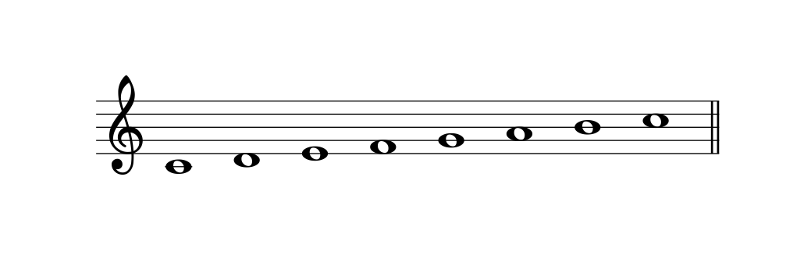
Make some noise!
Hit the compile button and your speaker should start making some noise! The tone function plays a square wave of your chosen pitch for a specified duration.
Have a go at getting Arduino to play a C major scale.
The frequency values for each tone function are:
C = 262Hz
D = 294Hz
E = 330Hz
F = 349Hz
G = 392Hz
A = 440Hz
B = 494Hz
C = 523Hz
Don’t forget the delays!
Try playing with the ordering of the notes and durations to make a tune. It’s kind of like a step sequencer.
Notes:
If you have a favorite note that you want to know the frequency for, I’ve got a nifty chart that gives you the frequency!

Slide 28
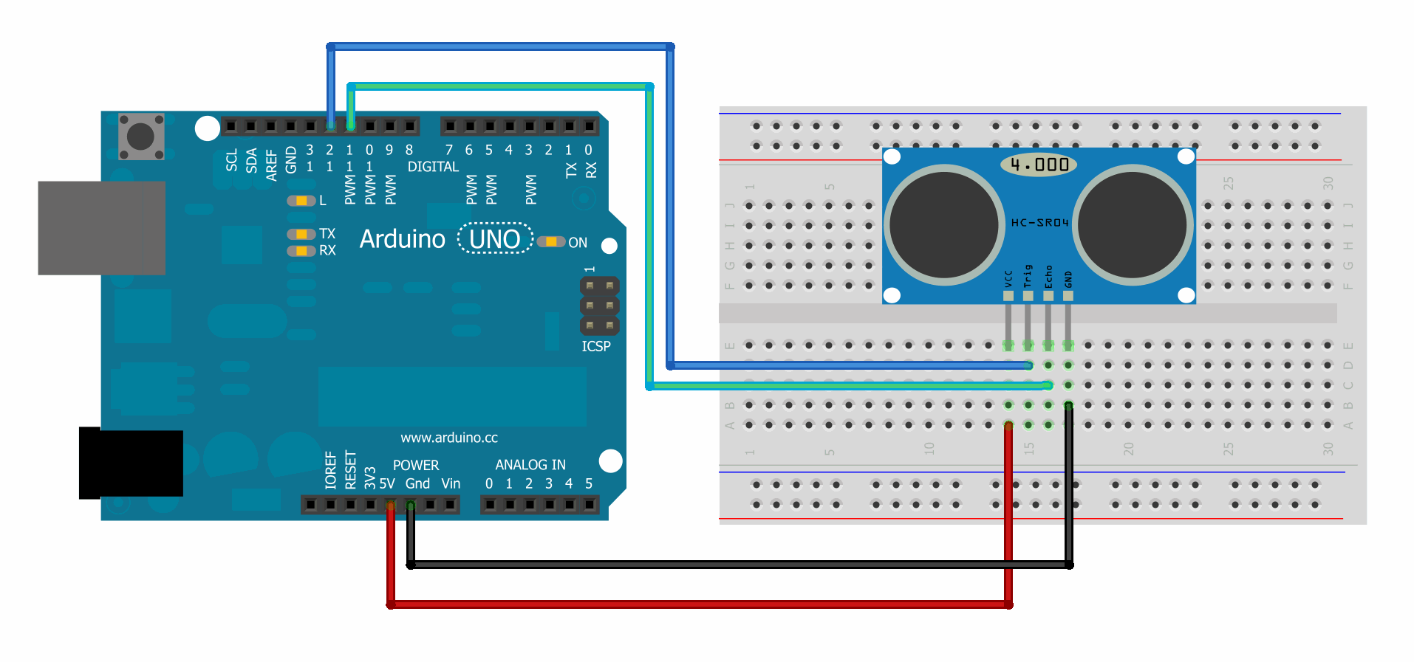
Measuring distance
This is an ultrasonic sensor it calculates the time between sending a sound and receiving the echo to work out distance it is from an object. This particular sensor, the HC-SR04 sends frequencies of 40,000Hz, with a maximum range of 4m and minimum of 2cm.
Connect the senor to the Arduino as shown in the diagram below. A list of connections is given on the next slide.

Slide 29
Measuring distance
Leave the speaker connected to the Arduino, we will be using it shortly! The pin connections are as follows:
HC-SR04 | Arduino
Vcc | 5V
Trig | 12
Echo | 11
Gnd | Gnd
You now have the whole of your Theremin-like instrument’s hardware setup ready!

Slide 30
Measuring distance
We are using the NewPing library to make it easier to get the Arduino talking to the ultrasonic sensor. Please download the library from here and install it like you did for the NewTone library. It is also in the folder for the workshop.
Ultrasonic Sensor
(Source: http://www.robosoftsystems.co.in/wikidocs/images/archive/8/84/20130108065629!HC-SR04.jpg)

Slide 31
Measuring distance
Copy and paste this code into a new Arduino IDE sketch.
#include <NewPing.h>
#define TRIGGER_PIN 12 // Arduino pin tied to trigger pin on the ultrasonic sensor.
#define ECHO_PIN 11 // Arduino pin tied to echo pin on the ultrasonic sensor.
#define MAX_DISTANCE 200 // Maximum distance we want to ping for (in centimeters).
NewPing sonar(TRIGGER_PIN, ECHO_PIN, MAX_DISTANCE); // NewPing setup of pins and maximum distance.
void setup() {
Serial.begin(115200); // Don’t worry about this for now :)
}
void loop() {
delay(50); // Wait 50ms between pings (about 20 pings/sec). 29ms should be the shortest delay between pings.
unsigned int sendPing= sonar.ping(); // Send ping, get ping time in microseconds.
unsigned int distanceMeasured= sendPing / US_ROUNDTRIP_CM ; // Convert ping time to distance in cm
// This prints out the distance measured by the sensor in a new screen
Serial.print("Ping: ");
Serial.print(distanceMeasured);
Serial.println("cm");
}
Notes:
There are 2 gnd pins on the Arduino

Slide 32
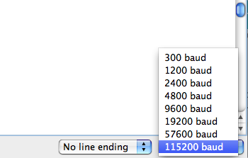
Measuring distance
Hit the compile button and upload the code to your Arduino.
Your code has uploaded, and you are flapping your hand back and forth in front of the sensor.. But how do you know that it is working?
The lines at the very bottom of the code print the values measure by the sensor to the Serial Monitor.
Press this button in the Arduino IDE to open the serial monitor.
If weird symbols are appearing, check that the baud rate is 115200 in the dropdown menu. Don’t worry, you don’t need to understand
this for now.
Notes:
I won’t go into detail about this today

Slide 33
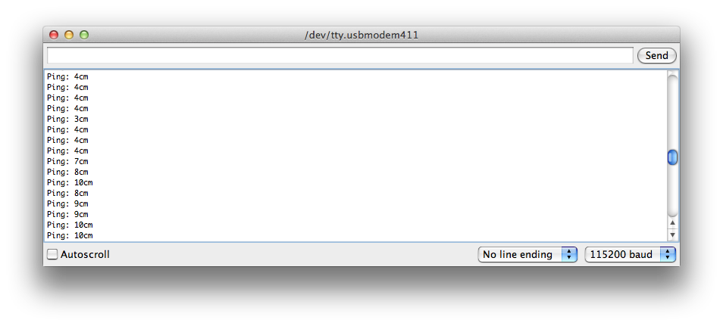
Measuring distance
If everything has gone smoothly, you should see values appear in the window like so:
The values are a little jumpy, if you use a piece of card, you get better readings.
Notes:
I won’t go into detail about this today

Slide 34
A Theremin-like Noise Maker
All the hardware is ready, so now we just need to merge the code and control the pitch produced by the speaker with the distance measured by the ultrasonic sensor.
This is a long one, so the code is over two slides!
#include <NewPing.h>
#define TRIGGER_PIN 12 // Arduino pin tied to trigger pin on the ultrasonic sensor.
#define ECHO_PIN 11 // Arduino pin tied to echo pin on the ultrasonic sensor.
#define MAX_DISTANCE 200 // Maximum distance we want to ping for (in centimeters).
const int speakerPin= 8; // The speaker is connected to pin 8 through a 100ohm resistor
NewPing sonar(TRIGGER_PIN, ECHO_PIN, MAX_DISTANCE); // NewPing setup of pins and maximum distance.
void setup() {
Serial.begin(115200); // Don’t worry about this for now :)
}
Notes:
I won’t go into detail about this today

Slide 35
A Theremin-like Noise Maker
void loop() {
delay(50); // Wait 50ms between pings (about 20 pings/sec). 29ms should be the shortest delay between pings.
unsigned int sendPing= sonar.ping(); // Send ping, get ping time in microseconds.
unsigned int distanceMeasured= sendPing / US_ROUNDTRIP_CM ; // Convert ping time to distance in cm
NewTone(speakerPin, distanceMeasured); // play a tone through speakerPin (pin 8) at a frequency defined by distance for 10ms
// This prints out the distance measured by the sensor in a new screen
Serial.print("Ping: ");
Serial.print(distanceMeasured);
Serial.println("cm");
}
Notes:
I won’t go into detail about this today

Slide 36
A Theremin-like Noise Maker
Ok so it kind of works, but it’s really low and has loads of random noise in it. We can do lots of things to change the sound, by altering the code highlighted in red.
You can add values to the distanceMeasured, for example
NewTone(speakerPin, distanceMeasured + 200);
Try multiplying the distanceMeasured by a value, for example:
NewTone(speakerPin, distanceMeasured * 10);
Notes:
I won’t go into detail about this today
Try changing PING distance to 100 for better readings

Slide 37
A Theremin-like Noise Maker
You can get rid of unwanted noise when there’s a zero reading by creating an if loop like so:
if(distanceMeasured == 0){
noNewTone;
}
if (distanceMeasured > 0 && distanceMeasured < 100){
NewTone(speakerPin, distanceMeasured * 10);
}
Just keep playing around till you find something you like the sound of!
Notes:
I won’t go into detail about this today
Try changing PING distance to 100 for better readings

Slide 38
Now it’s time to JAM
Get your noise makers ready, it’s time to play!!!!
Notes:
I won’t go into detail about this today
Try changing PING distance to 100 for better readings

Slide 39
Do it at home!
Here is a list of all the parts used in todays workshop. Everything apart from the ultrasonic sensor can be purchased from Farnell. Click on the order code for a link to each item’s webpage. One thing to remember is, Arduino’s don’t come with USB cables!
Company | Name | Order Code | Quantity
Farnell | Solderless Breadboard | 2213346 | 1
Farnell | Jumper Wires | 2315746 | 1
Fanell | Arduino Uno | 2285200 | 1
Farnell | Speaker | 4262323 | 1
Ebay | Ultrasonic Sensor | URL | 1
Farnell | 100ohm Resistor | 1903813 | 1

